Slide 1
Hoodlums and Saints

Slide 2
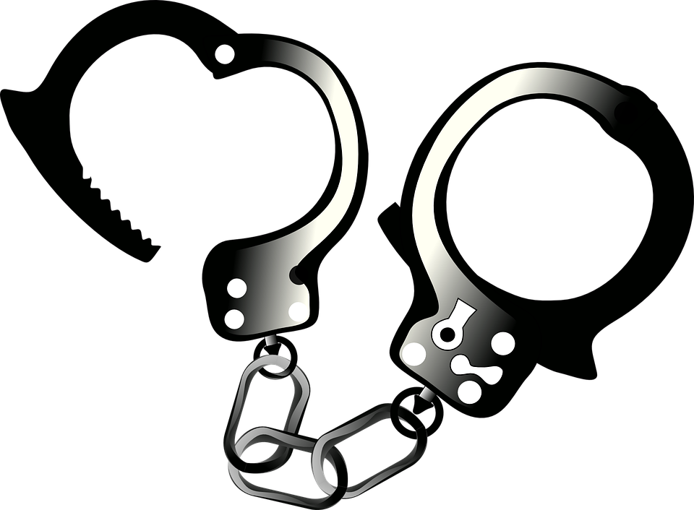
Introduction to Data Sets
The first dataset we picked was an arrest data set that shows all the arrests in each neighborhood along with the type of crime committed
The neighborhoods with the lower amount of crime, obviously means it is safer a neighborhood to live in

Slide 3
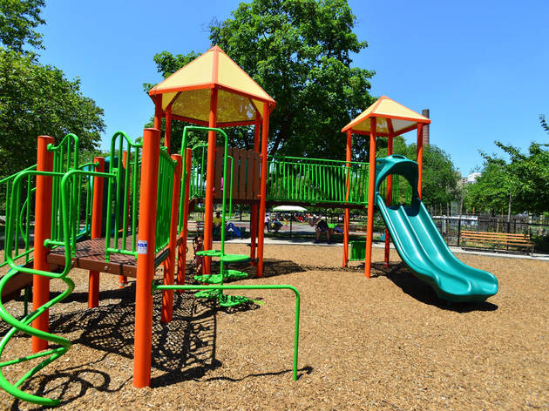
Introduction to Data Sets
The second dataset we picked was a data set displaying the amount of playgrounds, and their names, in each neighborhood
The neighborhoods with the higher amount of playgrounds is considered to be the better neighborhoods because they offer a safe and fun place for kids to hang out and play

Slide 4

Introduction to Data Sets
We also used public and private school data sets that displays the name what kind of school it is
We chose this data set because a better neighborhood will have more schools, with a more educated population
More private schools could also mean a better neighborhood

Slide 5
Arrest Data

Slide 6
Our Arrest Data
In our arrest data we weighted different types of crimes as such
5PTS - Murder, Voluntary Manslaughter
4PTS - Kidnapping
3PTS - Aggravated Assault, Recklessly Endangering Another Person
2PTS - Endangering Welfare of Children, Terroristic Threats
1PT - All other crimes

Slide 7
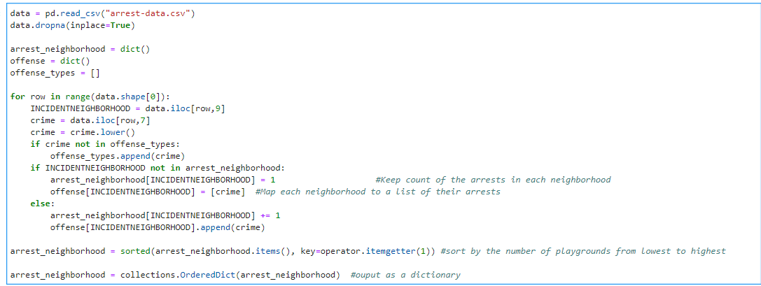
The Code

Slide 8
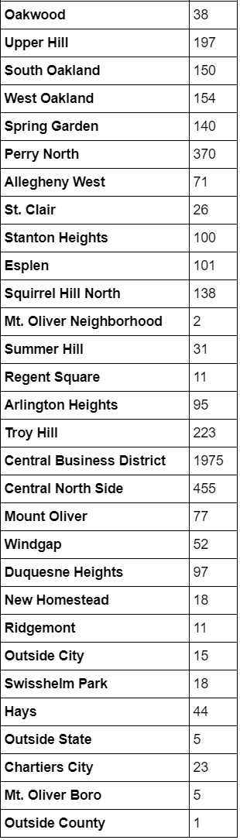
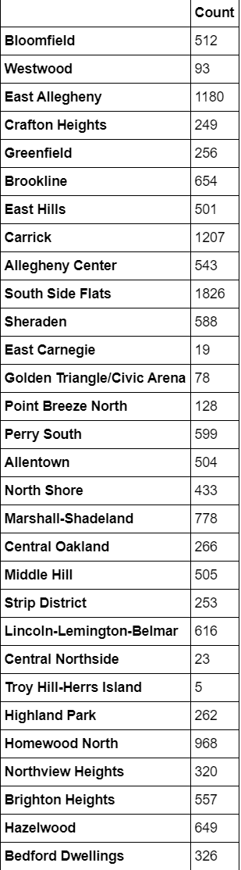
Number of arrests in each
Neighborhood

Slide 9
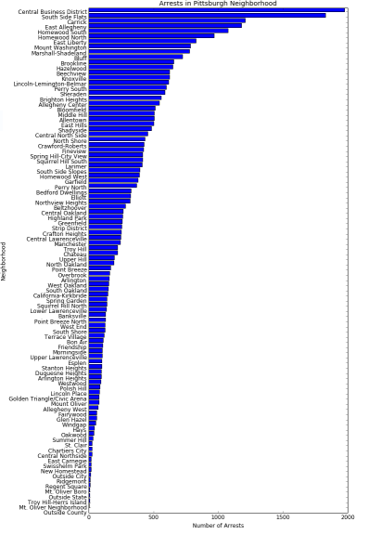
Arrest Graph

Slide 10
Data Analysis
Top 3 most arrests - Central Business District, South Side Flats, Carrick
Top 3 least arrests - Mt. Oliver Neighborhood, Troy Hill-Herrs Island, Mt. Oliver Boro

Slide 11
Playground Data

Slide 12
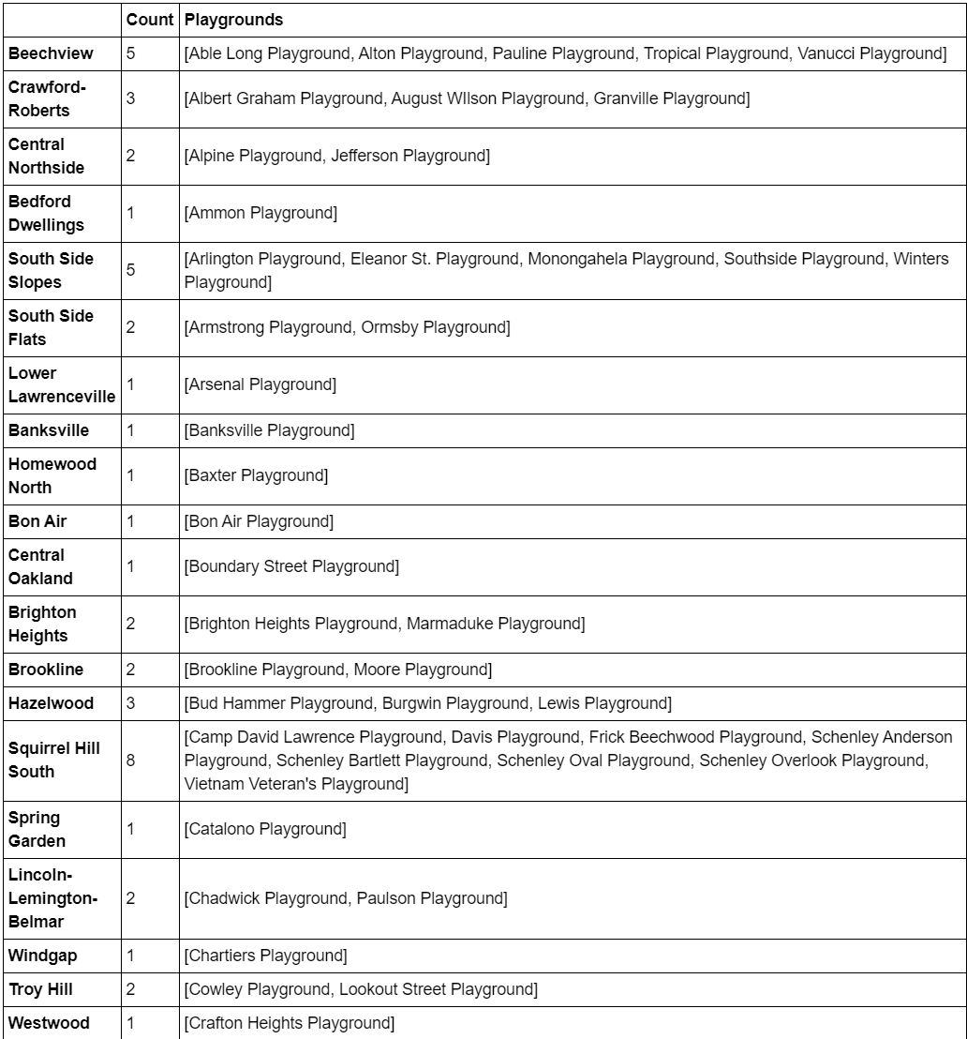
Number of playgrounds
per neighborhood

Slide 13
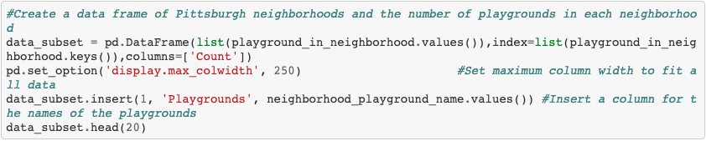
Script: Create a Table

Slide 14
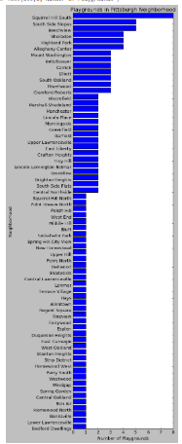
Numbers of playground

Slide 15
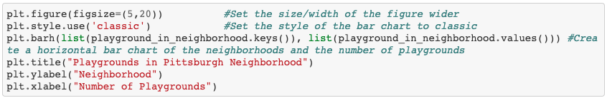
Script: Create Horizontal Bar Graph

Slide 16
Data Analysis
Top 3 most playgrounds - Squirrel Hill South, South Side Slopes, Beechview
Top 3 least playgrounds - Bedford Dwellings, Lower Lawrenceville, Banksville

Slide 17
Best Neighborhood Metric

Slide 18
Our Metric
Every private school the neighborhood had = +3 pts
Every playground the neighborhood had = +2 pt
Every public school the neighborhood had = +1 pt
This total score is then divided by the total amount of arrest points in that neighborhood (values stated earlier)

Slide 19
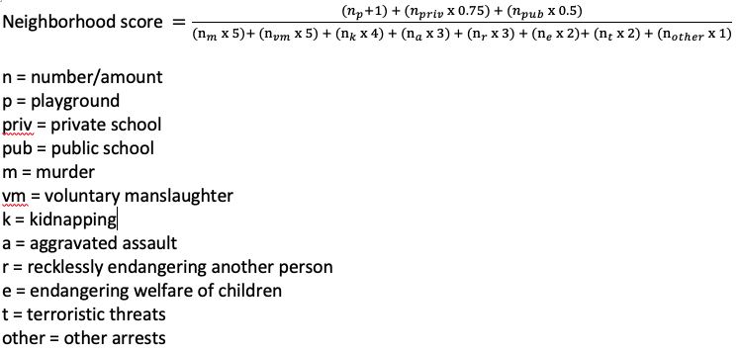
The Equation

Slide 20
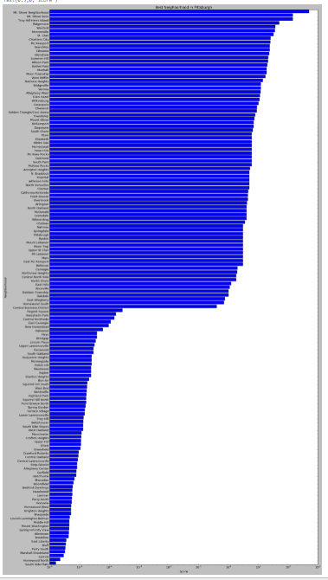
Neighborhood scores

Slide 21
Data Analysis
Best Neighborhoods (WINNERS)
Mt. Oliver Neighborhood - 500pts
Mt. Oliver Boro - 142.857pts
Troy Hill-Herrs Island - 142.857pts
Worst Neighborhoods (LOSERS)
South Side Flats - 0.000002pts
Homewood North - 0.000002pts
Carrick - 0.000003pts

Slide 22
Conclusion (Alex Gibala)
Overall, I am not surprised by the result of Mt Boro being the best neighborhood considering the little amount of crime it had, as well as having lots of playgrounds. I am very shocked that Squirrel Hill, my personal favorite, was not higher up in the best neighborhood scoring.

Slide 23
Conclusion (Ju Eun Lim)
I am not very familiar with Pittsburgh neighborhoods but out of the cities I have been to, I liked Monroeville because it was quiet and seemed like a safe area, and the part of Monroeville that I went to had relatively flat and straight roads. The housing rentals seem to be cheaper than other cities closer to the universities and downtown, but Monroeville is still reasonably close to Pittsburgh. Monroeville wasn't the best city based on the data driven determination. This makes sense because I have never been to Mt. Oliver, which turned out to be the best city. Moreover, the number of arrests is hard to notice just by visiting the city so I never considered that in my personal preference. Nevertheless, Monroeville is the 6th best neighborhood in Pittsburgh, so I would say it is fairly consistent with my idea of what the best Pittsburgh neighborhood is.

Slide 24
Conclusion (Ryan Nguyen)
I found that there are a lot of different areas in Pittsburgh with private schools, for example the places with the second most amounts of private schools besides Pittsburgh is Monroeville and Mount Lebanon We used this data to compare with our Arrest data and playground data to see what neighborhood has the most amount of schools, playgrounds, and least amount of arrests. Based on this information we were able to determine the “best neighborhood” in Pittsburgh.

